Slide 1

A/R Executive Pulse Week Ending 5.21.26

Slide 2
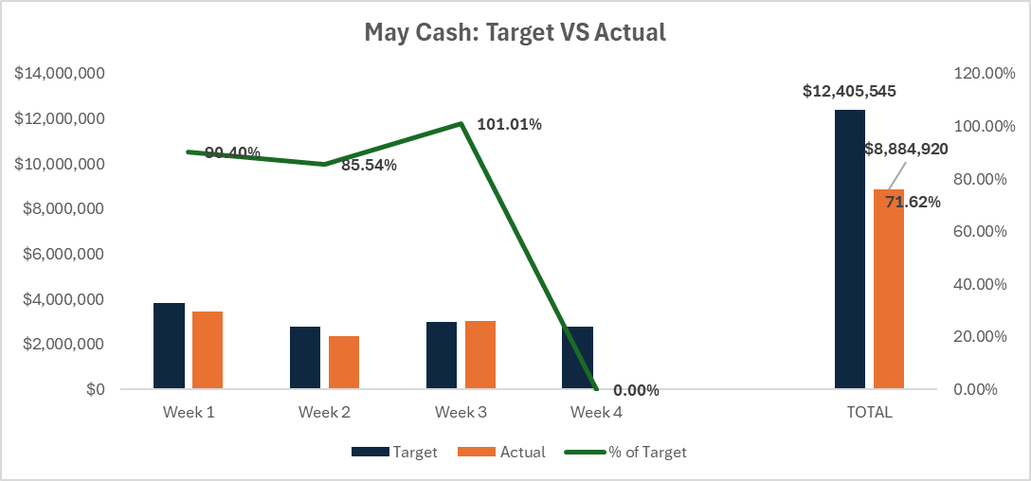
Executive Summary – Week Ending 5.21.26
 | Result
Cash (MTD) | $8.8M (72% to Target)
Cash (QTD) | $26.2M (58% to Target)
Days Sales Outstanding | 37
>60 Balance | $2.84M
>60 Collections This Week | $292k
>90 Balance | $1.40M (Ahead of Q2 target)
>90 Collections This Week | $297k
Forecast Confidence (Next 4 Weeks) | Medium
Risks to Cash / Forecast
No known risks to cash next week
What Changed This Week?
Decisions/ Updates
  30 day review of TAA (3rd party) placements, we are pleased with the overall progress and feel the relationship is promising.
Decisions/Asks
  Decision:
  Next Action:

Slide 3
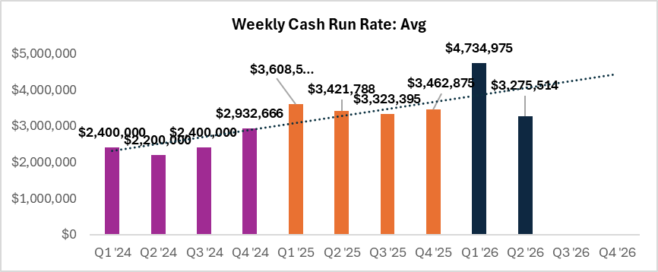
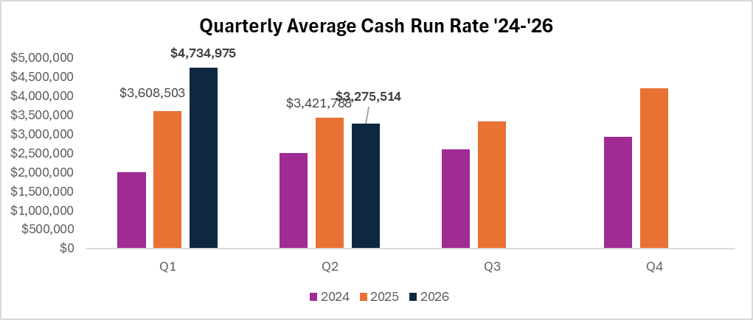
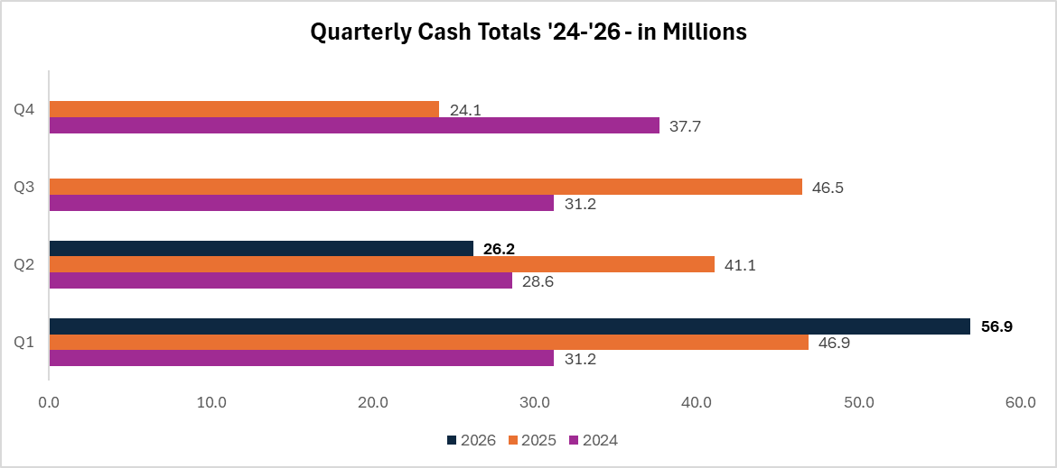
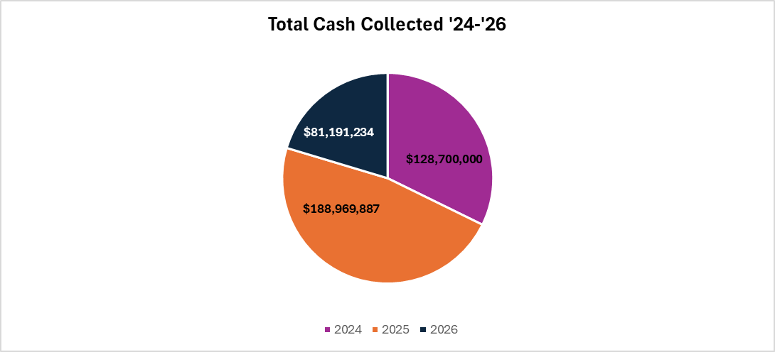
Trend: Weekly Cash Run Rate Activity
Q2 is sustaining elevated run rates, with weekly collections outperforming prior-year benchmarks.
Q2 trajectory is exceeding historical quarterly averages, signaling durable improvement in cash conversion efficiency over prior years
Q2 collections are pacing ahead of historical trends, positioning the business for another strong cash performance
2026 mix continues to shift upward, with increasing contribution to total cash collected while reinforcing year-over-year growth momentum

Slide 4
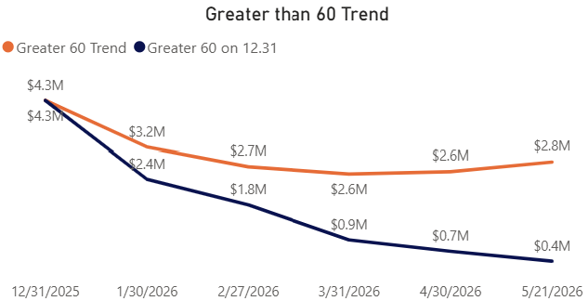
Aging Control: >60 Balance vs Target + Movement
Q2 Target = <<$2.90M
Decreased from $2.97M to $2.82M
Aging Controls | Results
Starting >60 | $2.97M
Rolled into >60 | $161k
Collected from >60 | $292k
Ending >60 | $2.82M

Slide 5
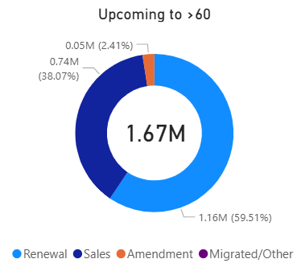
Forward Risk: Next 30 Days Likely to Roll
Top 4 Accounts Likely to Roll within 30 Days
Hallmark - $465K
Anheuser-Busch - $157k
Owens Corning - $91K
Amsted Industries - $85K
Payment received
Consolidated invoice sent a month late – payment promised for 6/1.
The customer has indicated they are actively working internally to issue the required PO. Accounts Receivable continues to follow up to confirm the expected payment timeline. On 5/21, AR reached out to Robert Brod to request an update, as the customer advised they are coordinating with him to finalize the PO.
The customer is disputing the invoice due to ongoing software issues and is considering filing a warranty claim. AM closely engaged with the customer and advised on 5/12 that efforts are underway to identify a resolution to the product concerns. Accounts Receivable followed up on 5/20 requesting an update on the status of the dispute and clarity on next steps required to resolve the outstanding balance.

Slide 6
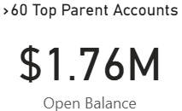
Current Risk: >60 Days Past Due Top 10 Customers
Customer | Aged AR Exposure | Current Status | Root Cause | LOB/GM Owner | Collection Timeline | Next Action/Blockers/Help Needed
Mars Information Systems | $252K | Payment Promised | Portal upload/ procurement misalignment | Eric/Phil | EOM | 5/20 The consolidated invoice was issued on 1/9 and uploaded to the portal on 2/11, where it was initially rejected due to tax being included. After receiving the customer’s tax exemption documentation, the invoice was credited, corrected, and re‑uploaded on 3/11. The customer has confirmed that payment is scheduled to be processed on May 20.
Nelt Group | $190K | Payment in progress/ remaining dispute resolution in progess | Customer historically slow to submit payment regardless of dispute | Penn High | EOQ | 5/21 Most customer disputes have now been resolved. The customer confirmed that the $111K invoice has been submitted for payment, with expected receipt within the next 10 days. A payment of $26K was received on 5/15. The Advantive team continues to work toward resolution of any remaining disputed invoices to support full payment of the outstanding balance.
Bjornstad Construction Supply | $166K | Demand Letter sent/ potential settlement negotiations | Customer unresponsive to outreach regarding implementation and past due balance | Penn High | TBD | 5/21 A demand and termination letter was issued on 5/6. The customer responded requesting a detailed breakdown of expenses incurred by Advantive to date; however, this request was reviewed by Legal and denied. On 5/20, Jordan Duke initiated outreach to negotiate a potential settlement and requested confirmation of the customer’s intent to either proceed with or cancel the implementation. The team is currently awaiting the customer’s response to determine next steps.
Leadersoft (Xuhui,31) | $129K | Requested documents and USB drives in progress to be shipped to customer | Government requirement for invoice payment | Kevin Keene | EOQ | 5/21 Jordan is preparing shipment materials, including two USB drives, two commercial invoices, two invoices, and the required customs declaration paperwork for each package. On 5/20, Jordan confirmed to the customer that all materials will be completed and shipped by end of week, with tracking details to be provided upon dispatch.
Mondelez International | $116K | Multiple Accounts, various issues moving toward resolution | Tax, Portal Issues, Invoices delivery Issues, terms discrepancy, GR customer side issues | Eric/Phil | EOQ | 5/20 Mondelez delinquency is widely dispersed, GR/approval gaps, and portal/PO setup issues, with active escalations, and customer side urgent payment actions underway. PE Declaration and FORM 41 holding up payment on Mdlz India, SF Case to Legal for forms; Missing $13K payment from Mdlz US, working to get reissued.
International Motors | $115K | Paid | Portal Issues | Eric/Phil | EOM | 5/21 received payment 5/20
DS Smith PLC | $85K | Disputed Invoices | Implementation Issues | Penn High | EOQ | 5/21 P2P $55K DSS Martin from Roman, payment will clear most of the 60+ past due for DSS; 5/20 UK Caerphilly €30K, Howard A. (DSS) replied w/ cancelation for sites sent February; Slovakia €35K Customer claims QMS & TSS moduls not in live in Martin, refusal to pay S&M, escalated to David Loftus to address w/ Roman, following up in bi-weekly meet w/ SAM.
Marx Foods | $82K | Demand letter sent 4/6 | Implementation dispute | Kevin Keene | TBD | 5/21 A demand and termination letter was issued on 4/6. The customer’s legal team responded disputing the outstanding balance, citing implementation delays and alleging breach of contract, and denied payment. A settlement offer was presented on 5/8; however, the customer rejected the proposal and submitted a counterclaim requesting reimbursement of prior payments. On 5/20, Legal (Suketa) formally rejected the reimbursement demand and issued a final request for full payment within 10 days, advising that failure to comply may result in referral to a third‑party collections agency.
Auto One | $81K | Customer disputing billed products due to unclear information provided during the sales process; Solution pending customer approval | IProduct dispute | Eric/ Phil | TBD | 5/21 legacy Commerce Vision account continues to challenge the value of the MAF platform due to its dependency on the eCommerce solution not being clearly communicated prior to the transition to Advantive. On 5/6, Customer Success presented a proposal offering a 50% credit on the past‑due balance in exchange for a 24‑month renewal, with the remaining balance payable. The proposal remains pending customer approval. Accounts Receivable has followed up multiple times, most recently on 5/20, but there has been limited responsiveness from Customer Success (Andrew Harvey), delaying visibility into the customer’s position and next steps.
AVID Logistics | $67K | Demand Letter Sent | unresponsive | Eric/ Phil | TBD | 5/21 - Customer placed with 3rd party collections

Slide 7
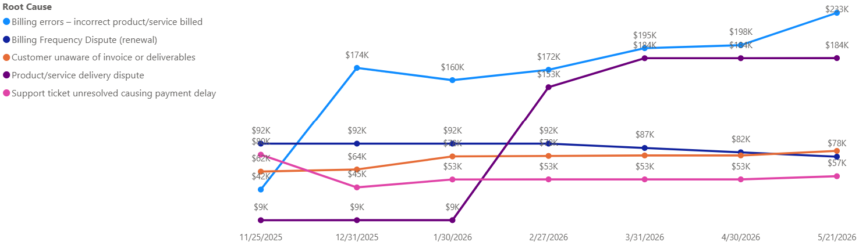
Root Causes: What’s Driving Non-Payment + What We’re Doing
Top 3 Causes
  Billing Errors – Incorrect product/ service
  Product/service delivery dispute
  Customer unaware of invoice
What Changed This Week
  Increase to Billing Errors related to first of month billing
  Decreases to other buckets this week as we work through issues
ELT/Cross-Functional Ask
  Continued cross functional collaboration to research, action, and resolve product and service billing discrepancies.

Slide 8

Appendix

Slide 9
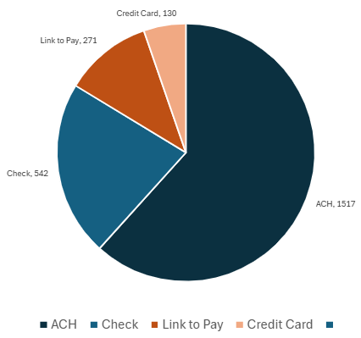
Scoreboard: Cash vs Plan (MTD / QTD + Drivers)
Payment Methods
May: 47% MTD Attainment
Q2: 51% QTD Attainment
Highlights:
May Daily average: $561k
Top Movers
    Hallmark - $434k
    Mpact Operations - $228k
    Crown Bakeries - $196k

Slide 10
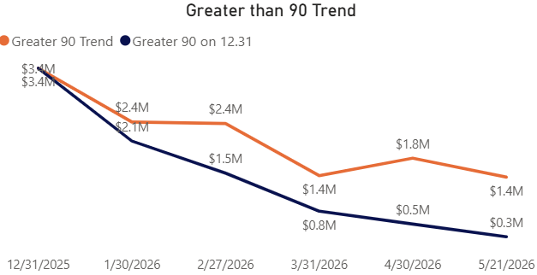
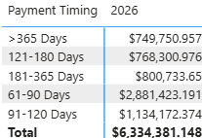
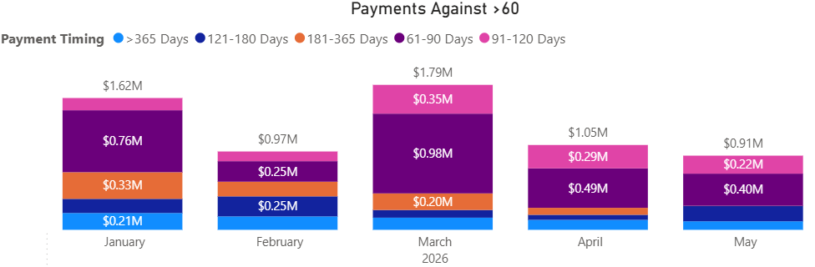
Aging Control: >90 Balance vs Target + Movement
Q2 Target = <<$2.28M
Decreased from $1.62M to $1.40M
FY26
Aging Controls | Results
Starting >90 | $1.62M
Rolled into >90 | $84k
Collected from >90 | $297k
Credits/Write-offs | $0
Ending >90 | $1.40M

Slide 11
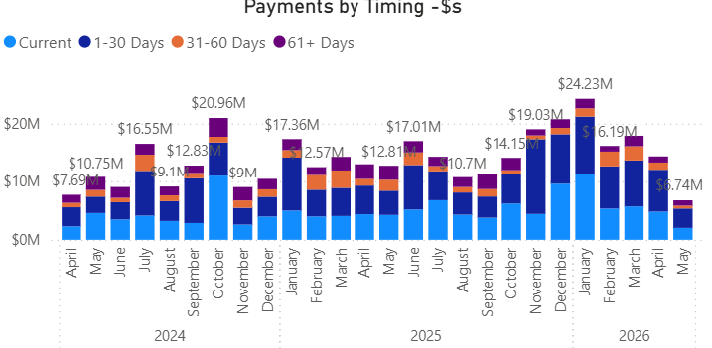
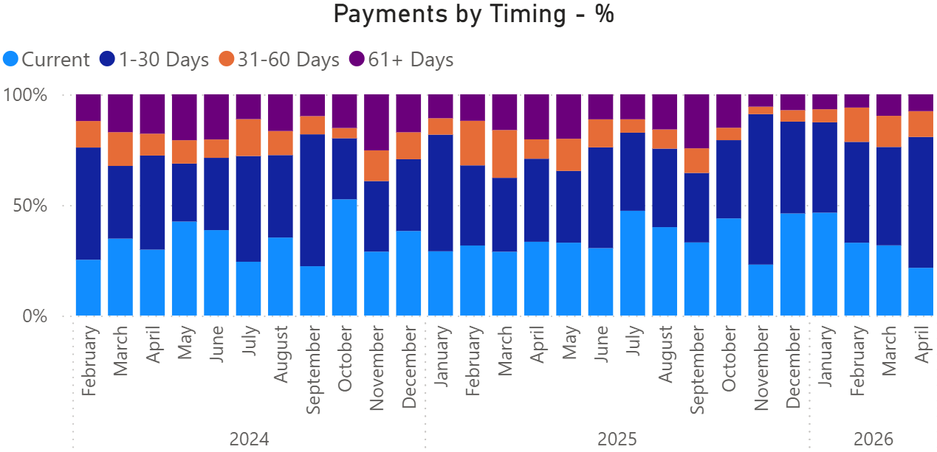
Levers: Holds – Yields, Risk & Guardrails
Holds | Results
Under Threat | 77 Accounts
On Hold | 300 Accounts
Hold Related Payments | $9M

